Slide 1

Singleton Pattern for Used Car System
By Satar Hassni

Slide 2
Which parts are required to be in the singleton pattern?
The car repo.
The used car factory.
The car database.
Because these parts of our application will only have one instance during run time.

Slide 3
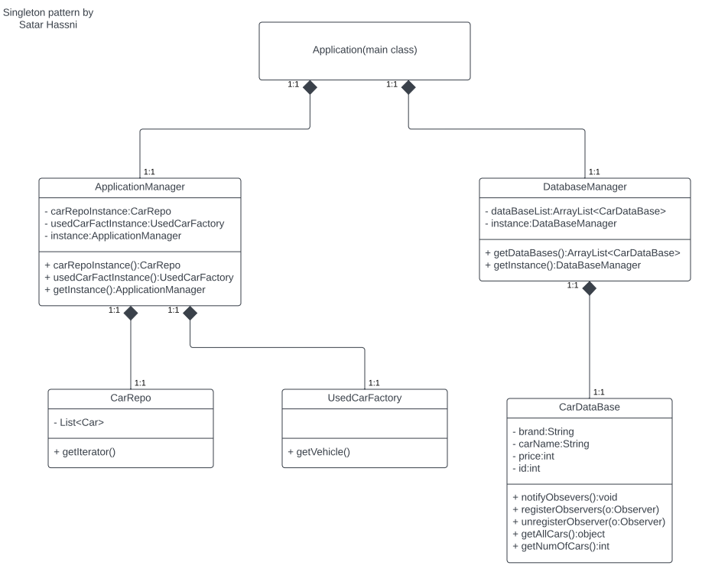

Slide 4
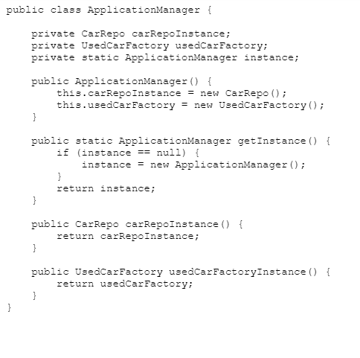

Slide 5
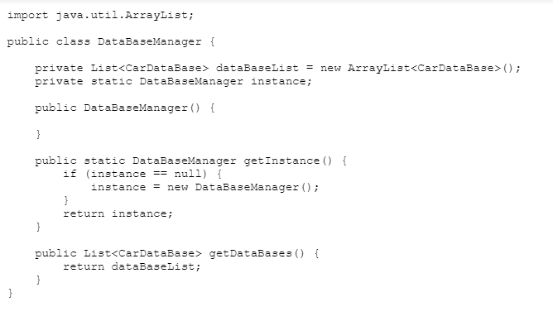

Slide 6
Benefits?
Although you can specifically make one instance in the main class this makes it cleaner and maintainable!
Easier to modify one specific class then every place it's called.
No need to directly call Main class with a static call to the instance of said object (generally very bad practice).

